Slide 1


VV
VERVE BRIDGE
TASK 1:
NATIONAL BASKETBALL ASSOCIATION PLAYER ANALYSIS
- KHUSHI

Slide 2
TABLE OF CONTENT
INTRODUCTION
OBJECTIVE
TOOLS & TECHNIQUE UTILIZED
METHODOLOGY
PROBLEM STATEMENT
DATA COLLECTION & CLEANING
DESCRIPTIVE & CORRELATION ANALYSIS
PREDICTIVE MODELLING
DASHBOARD & KEY INSIGHTS
RECOMMADATION
SUMMARY

Slide 3
Introduction
The NBA Draft Combine is a crucial event where draft-eligible players undergo various physical and skill tests. These measurements, including height, weight, vertical leap, and agility, offer valuable insights into a player's athleticism and potential. This analysis aims to uncover patterns and trends in the combine data to predict player success in the NBA. By examining these measurements, we can better understand their impact on a player's performance and assist teams in making informed draft decisions.

Slide 4
OBJECTIVE
The objective of this analysis is to identify and interpret patterns and insights from NBA Draft Combine measurements. By examining these metrics, we aim to assess their predictive value for player success in the NBA, helping teams make more informed decisions during the draft process.

Slide 5
TOOLS & TECHNOLOGIES
POWER BI
EXCEL
MYSQL
IBM SPSS
CHATGPT

Slide 6
METHODOLOGY
Data Cleaning
Statistical Analysis
Visualization
Data Collection
Exploratory Analysis
Modeling
Reporting

Slide 7
PROBLEM STATEMENT
The NBA Draft Combine provides crucial measurements of prospective players, such as height, weight, and agility. However, teams often struggle to interpret these metrics in the context of predicting future NBA success. This project aims to analyze combine measurement data to identify key patterns and correlations that can improve the accuracy of player evaluations and assist teams in making more informed draft decisions.

Slide 8
DATA COLLECTION
Data was collected from Kaggle by logging in and searching for NBA Draft Combine datasets. After selecting and downloading the relevant data, it was reviewed for completeness. The dataset was then cleaned and preprocessed to ensure accuracy and consistency before analysis.

Slide 9
DATA CLEANING
The steps are taken to clean the data :
Remove duplicates
Handle missing values
Correct errors
Normalize data
Outlier Detection
Data Transformation
I USED EXCEL TO CLEAN DATA.

Slide 10
DATA ANALYSIS
The steps are taken to analysis :
Descriptive Analysis
Correlation Analysis
Predictive Modeling
Visualization

Slide 11
DESCRIPTIVE ANALYSIS
Objective : To summarize the key metrics and attributes of players.
Key Points : Calculated averages and totals for attributes like hand size, wingspan, height, and bench press . Visualized these statistics in bar charts and pie charts to showcase player performance and physical attributes.
Insight : Average wingspan, height, and vertical jump give a quick overview of physical characteristics of top-performing players.

Slide 12
CORRELATION ANALYSIS
Objective: To identify relationships between different physical attributes and draft success.
Key Points : Conducted correlation analysis between wingspan, vertical reach, sprint times, and draft pick. Used scatter plots to visualize strong relationships.
Insight: Negative correlations found between wingspan and draft pick rank.
Positive correlations found between weight and sprint.

Slide 13
PREDICTIVE MODELLING
Objective: To predict NBA Draft success using physical and performance metrics.
Key Points :Applied linear regression models to predict draft pick based on factors like wingspan, vertical reach, and agility. Using Excel’s regression analysis tools to evaluate model accuracy (R-squared values).
Insight: The predictive model highlights which attributes (e.g., agility, vertical reach) most influence draft outcomes.

Slide 14
VISUALIZATION
In this project, visualization plays a crucial role in representing and interpreting the NBA Draft Combine data. By using bar charts, scatter plots, pie charts, and regression models, we transform raw data into visually understandable formats. These visualizations help in summarizing key metrics such as player height, wingspan, and performance metrics, while also identifying correlations between attributes like wingspan and draft position. Visualization enhances our ability to compare data across years (2009-2017), uncover patterns, and predict outcomes, making complex insights more accessible and actionable for decision-making.

Slide 15
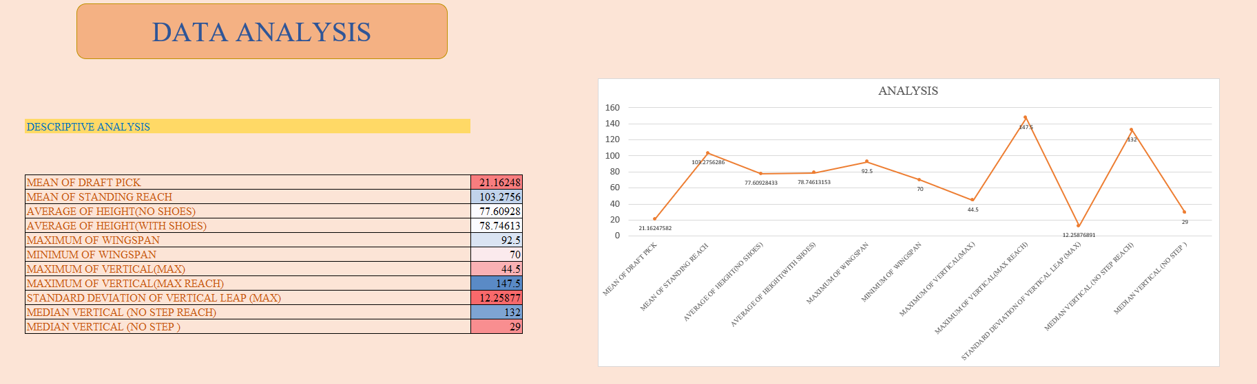

Slide 16
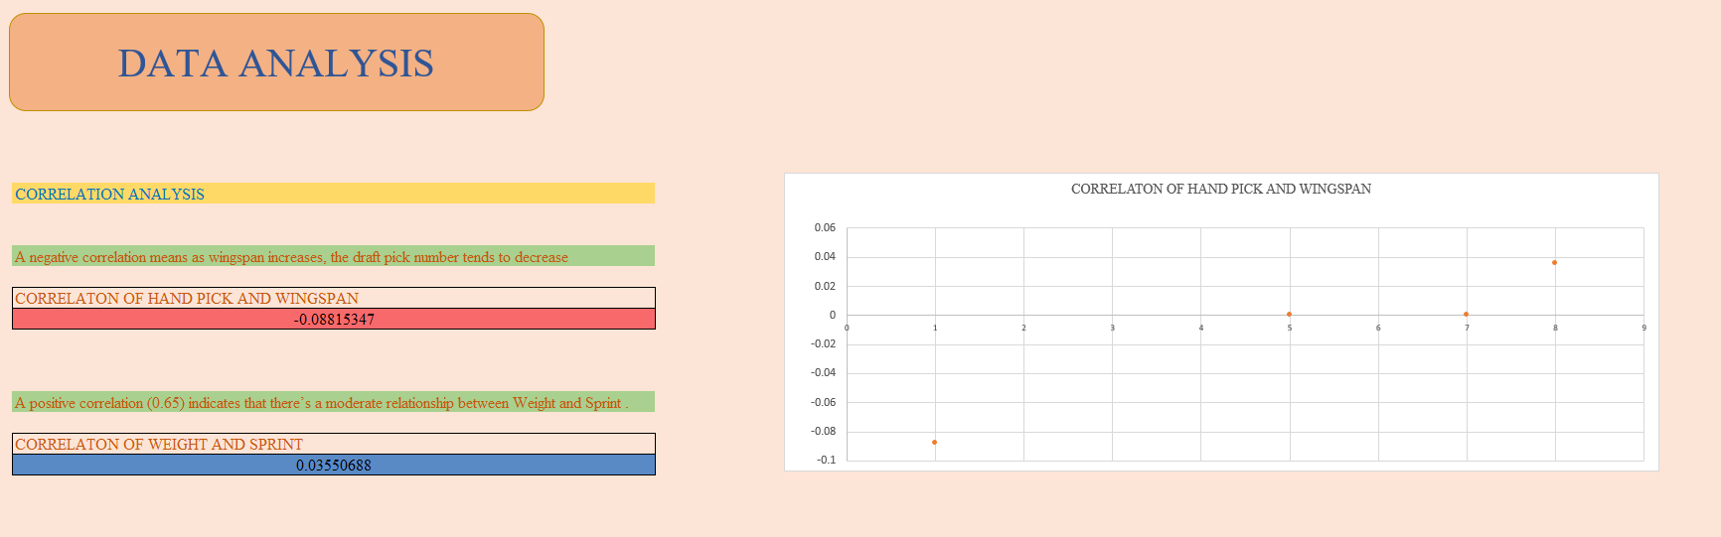

Slide 17
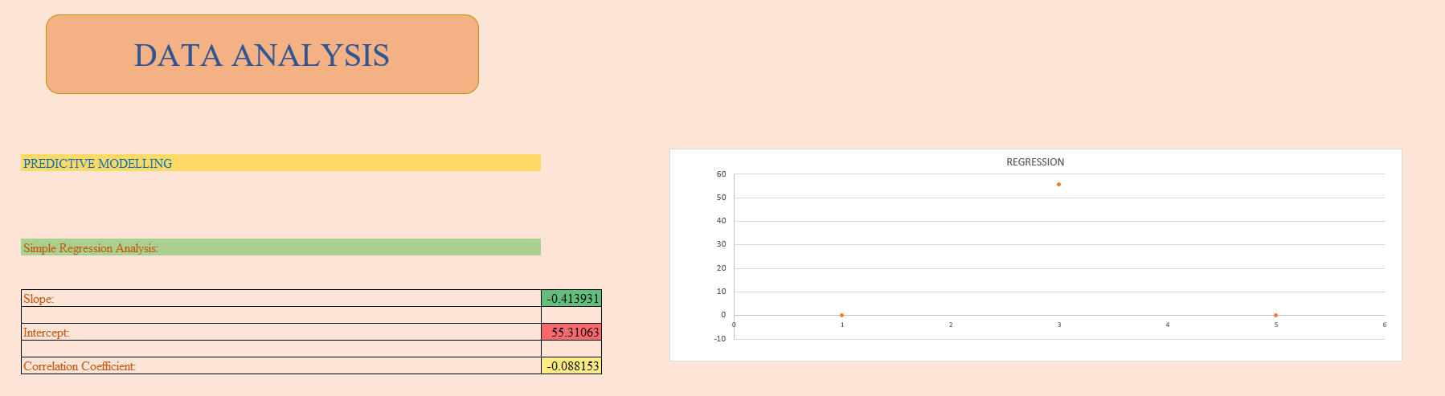

Slide 18
KEY INSIGHT
The analysis of NBA Draft Combine measurements provides
valuable insights into player performance trends and factors influencing draft evaluations. By examining vertical jump heights and related metrics over several years, we can uncover significant patterns and trends that offer a deeper understanding of player athleticism and training effectiveness.
Draft Pick (Average):The average draft pick is 21.16, giving an idea of the typical placement for players in the NBA Draft.
Bench (Total): The total bench score across all players is 2908, likely referring to performance in strength exercises.
Wingspan (Total) : The total wingspan measurement is 42.65K, reflecting the cumulative length of players' wingspans.

Slide 19
KEY INSIGHT
Hand Width and Length : The bar chart on the left shows the sum of hand width and length by player. It appears that some players like Greg Smith and Noah Vonleh have notable hand size metrics.
Vertical (Max Reach): The maximum vertical reach across players is 124.35K,
while the vertical without a step reach sums to 62.18K, indicating key performance measures in jump reach abilities.
Body Fat and Weight : This chart compares body fat percentages and total weight by player. Dexter Pittman and DeMarcus Cousins seem to have high body fat and weight compared to others.
Height (With/Without Shoes): The bar chart shows a comparison between players’ heights with and without shoes, highlighting height variations between players.

Slide 20
.
KEY INSIGHT
Sprint and Agility: The sum of sprint and agility metrics indicates performance in these areas for different players. Some players, like Jameel Warney and Anthony Bennett, appear to perform well in both.
Year Filter: The dashboard is set to visualize data from the year 2009 and 2017, giving the flexibility to explore performance trends across different years.
This dashboard provides a comprehensive view of players' physical attributes and performance metrics, allowing for comparison between key characteristics like hand size, vertical reach, sprint, agility, and more.

Slide 21
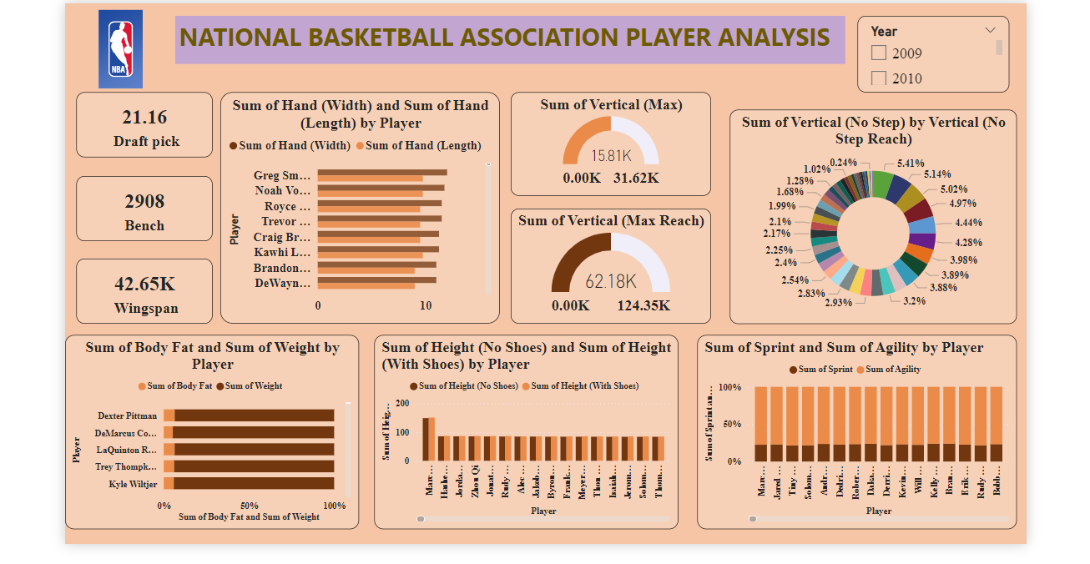
NBA ANALYSIS DASHBOARD

Slide 22
RECOMMANDATIONS
Based on your NBA Draft Combine Measurements project, here are recommendations:
Prioritize Key Measurements: Focus on height and wingspan, as these have shown strong correlations with draft success. Emphasize these metrics in scouting reports.
Use Predictive Modeling: Implement your regression model to forecast draft positions, aiding in identifying high-value prospects.
Enhance Player Development: Develop training programs to improve critical metrics like vertical leap and agility, which impact player success.
Standardize Evaluation: Adopt uniform procedures for measuring combine metrics to reduce variability and ensure consistency.
Refine Draft Strategies: Target players within optimal measurement ranges identified in your analysis to improve draft outcomes.

Slide 23
SUMMARY
The NBA Draft Combine dataset (2009-2017) contains key physical measurements and performance metrics for players, including hand size, wingspan, height, body fat, and weight. It also includes performance indicators like bench press, vertical jump, sprint, and agility, essential for assessing athletic potential. The average draft pick is 21.16, and the data enables comparisons between physical attributes and draft success. With a slicer for year-wise analysis (2009-2017), it tracks trends and player performance evolution over time. Initial correlation analysis suggests that attributes like wingspan and agility are significant predictors of draft outcomes. This comprehensive dataset provides valuable insights into player potential and success factors in the NBA.

Slide 24




THANK YOU
9306247377
chhabrakhushi26@gmail.com
H.No.-254, Inderpuri Mohalla, ,Palwal, 121102
WWW.VERVEBRIDGE.COM

